Slide 1
Designing With Intention
Applying Colour Theory

Slide 2
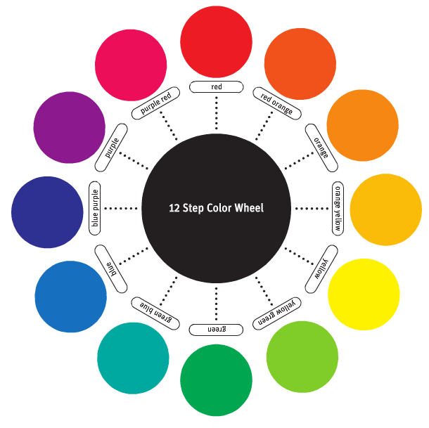
12-Step colour Wheel
Notes:
Let’s start with a recap of the 12 step colour Wheel
Colour theory is, at its core, about developing aesthetically pleasing colour relationships.
One of the best tools for visualizing colour relationships is the colour wheel. This wheel, originally developed by Sir Isaac Newton, can be constructed with just a few colours, or can be quite complex, incorporating many colour variations.
Perhaps the most useful version is the twelve-step colour wheel containing twelve pure hues, as shown.

Slide 3
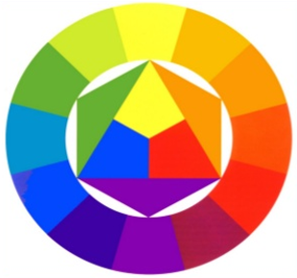
Primary Colours
Yellow
Yellow, Red and Blue
Blue
Red
Notes:
Primary colours:
There are three primary colours.
They are the hues yellow, blue and red.
These three colours are the hues that in theory can be mixed to make all other colours.
If you mix the three primary colours, in theory it would produce black.
Red, yellow, and blue are the primary colors of the artists' spectrum.
They are the simplest hues.
They cannot be broken down visually into other colors or reduced into component parts.
The primary colors are the most different from each other because they have no elements in common.
All colors on the artists' spectrum are mixed visually from the primaries red, yellow, and blue.

Slide 4
Secondary Colours
Created by mixing equal parts of two primary colours
Green = Yellow + Blue
Orange = Yellow + Red
Violet = Blue + Red
Green
Orange
Violet
Notes:
green, orange, and violet are the secondary colors of the artists' spectrum. Each secondary color is an even interval, or visual midpoint, between two primary colors:
Green is the middle mix of blue and yellow.
Orange is the middle mix of red and yellow.
Violet is the middle mix of blue and red.
The secondary colors are less contrasting in hue than the primary colors. Each secondary color contains a primary in common with one of the others. Orange and violet each contain red, orange and green each contain yellow, and green and violet each contain blue.
Yellow-orange, red-orange, red-violet, blue-violet, blue-green, and yellow-green are the intermediate colors. They are the midpoints between the primary and secondary hues. Like the secondary colors, each is made up of two primaries, but in different proportions. Many times these colors are referred to as tertiary colors, but this is inaccurate. Tertiary colors contain three primary colors, not two.⁴
Secondary colours:
Secondary colours: By mixing two primary hues together you create a secondary colour. There are three secondary colours. They are the hues green, violet (purple) and orange. Orange from mixing red and yellow, violet (purple) from blue and red, and green from yellow and blue.

Slide 5
Tertiary Colours
Created by mixing one secondary colour and one primary colour
When naming tertiary colours, primary colour is listed first and secondary colour is listed second
Yellow
Green
Yellow
Orange
Blue
Green
Red
Orange
Blue
Violet
Red
Violet
Notes:
Yellow-orange, red-orange, red-violet, blue-violet, blue-green, and yellow-green are the intermediate colors. They are the midpoints between the primary and secondary hues. Like the secondary colors, each is made up of two primaries, but in different proportions.
Tetiary colours:
Tertiary colours: The third set of hues are known as tertiary or intermediate colours. These hues are made by mixing adjacent primary and secondary hues. The six tertiary or intermediate colours are yellow-green, blue-green, blue-violet, red-violet, red-orange, and yellow-orange.

Slide 6
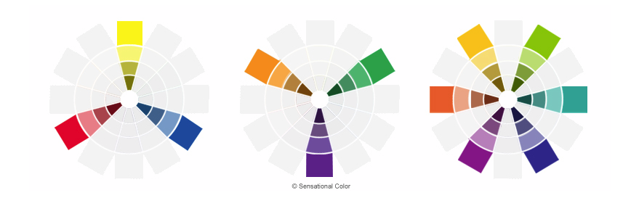
colour Relationships:
Contrast and Harmony
Harmony – pleasing colour relationships
Contrast – striking differences that create impact
Notes:
Harmony – pleasing colour relationships
Contrast – striking differences that create impact
Starts with these three:
Primary colours:
Secondary colours:
Tetiary colours:

Slide 7
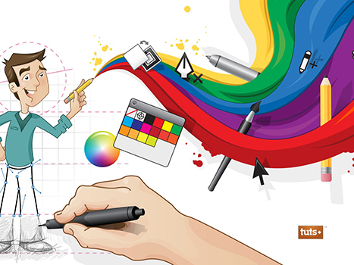
Colour:
Emotion & Branding
Colours evoke emotions and associations
Colour choices influence consumer behaviour
Reinforces brand identity and recognition
Notes:
1. Colour Choices Influence Consumer Behaviour
Colours affect us emotionally and even physiologically. For example, red can raise heart rate and create urgency, while blue tends to calm us down.
Marketers use this intentionally: sales tags are often red to push urgency, while banks use blue to build trust.
As designers, you need to ask: what behaviour am I trying to encourage? What colour choice will support that?
2. Reinforces Brand Identity & Recognition
Consistent use of colour creates brand memory. Think about Coca-Cola’s red—no logo needed, and you’d still recognize the brand.
When a company ‘owns’ a colour, they create instant recognition. Tiffany’s robin egg blue is so specific that people call it ‘Tiffany Blue.’
Colour is shorthand for identity. When you’re designing, ask: Does the colour palette reinforce who this brand is?
The human eye and brain experience colour physically, mentally, and emotionally As a result, colours themselves have meanings
colour symbolism is often a cultural agreement, and opinions about the associations are varied and sometimes conﬂicting
Lets look at a sampling of colour meanings, associations, and anecdotal information about colour
Be sure to investigate a particular colour’s meanings and associations before using it in a project for any medium

Slide 8
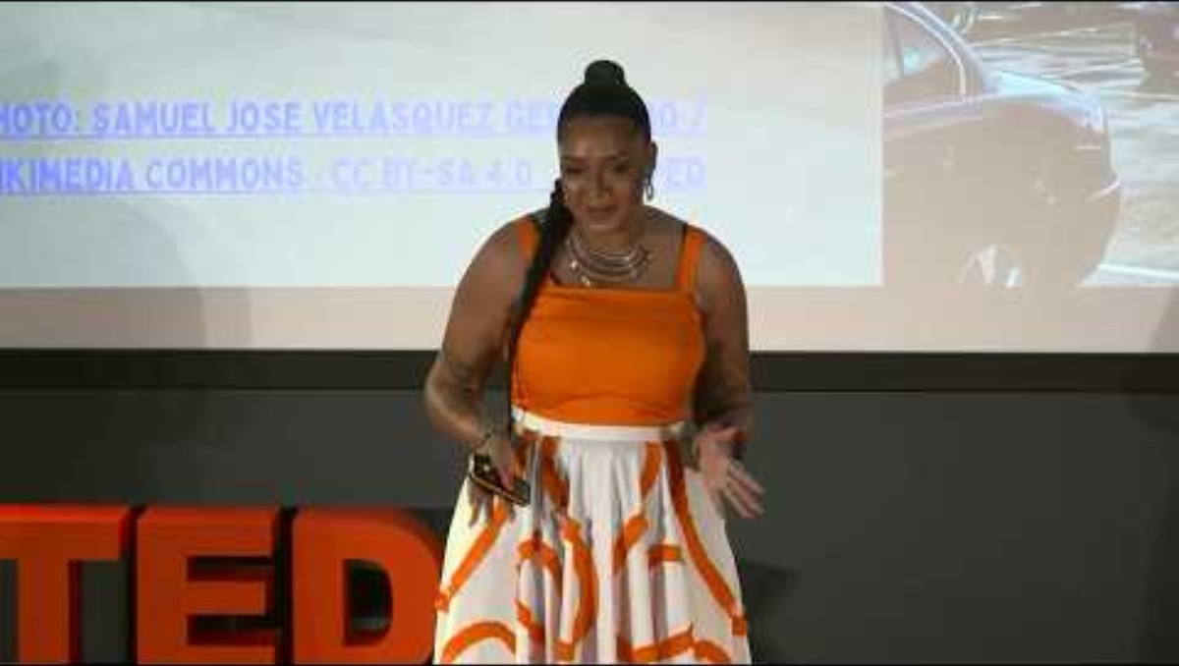
Notes:
https://youtu.be/QwZi0WLd3pc?si=BZVODYQemaR09_29
Why Colour Matters | Lily Hammond | TEDxUniversity of Suffolk
TEDx Talks

Slide 9
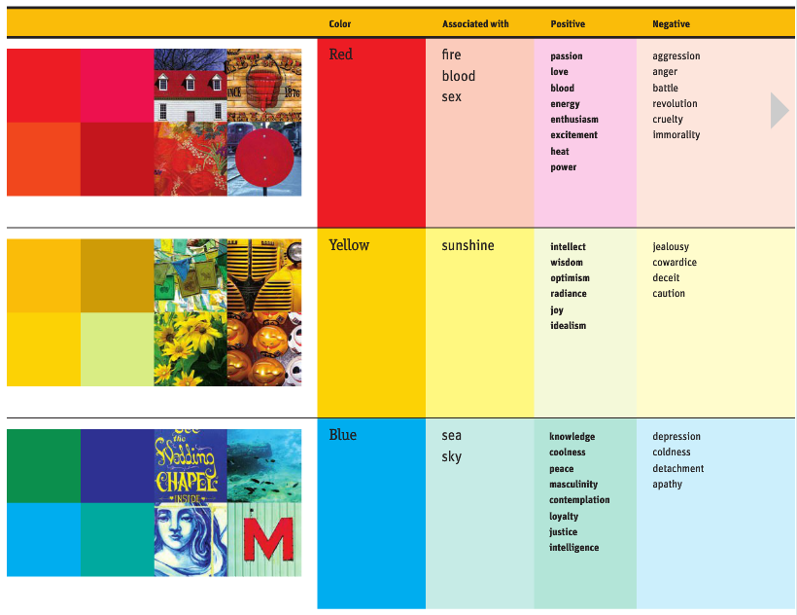
Primary colour Meaning:
Red

Slide 10
Red
Associated with | Positive | Negative | Extra
Fire Blood Sex | Passion Love Blood Energy Enthusiasm Excitement Heat Power | Aggression Anger Battle Revolution Cruelty Immorality | Most visually dominant colour Suggests speed & action Stimulates heart rate, breathing, appetite People appear heavier in red clothes Red cars stolen most often
Notes:
Red is associated with fire, blood, and sex Positively, it conveys passion, love, and energy Negatively, it can suggest aggression and danger In design, it grabs attention and creates urgency

Slide 11
Primary colour Meaning:
Yellow

Slide 12
Yellow
Associated with | Positive | Negative | Extra
Sunshine | Intellect Wisdom Optimism Radiance Joy Idealism | Jealousy Cowardice Deceit Caution | First colour human eye notices Brighter than white Speeds metabolism Bright yellow = fatiguing, irritates eyes Pale yellow boosts concentration
Notes:
Yellow represents sunshine and optimism It suggests intellect and joy but can also convey jealousy or deceit It is bright and stimulating but may tire the eyes if overused

Slide 13
Primary colour Meaning:
Blue

Slide 14
Blue
Associated with | Positive | Negative | Extra
Sea Sky | Knowledge Coolness Peace Masculinity Contemplation Loyalty Justice Intelligence | Depression Coldness Detachment Apathy | Rare in food → suppresses appetite Produces calming chemicals Boosts productivity in rooms Symbolizes trust/loyalty in clothing
Notes:
Blue reflects the sea and sky It is calming, linked with knowledge and loyalty, but can also suggest coldness or depression It’s widely used in corporate branding for trust

Slide 15
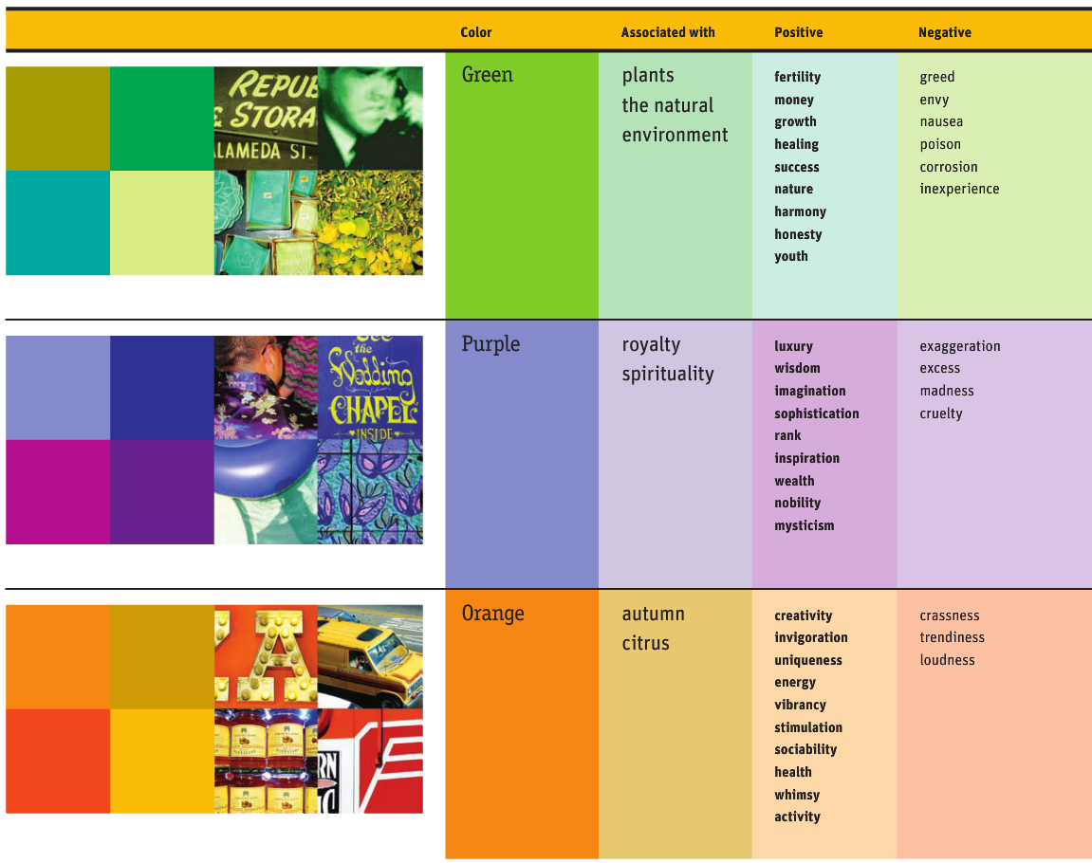
Secondary colour Meaning:
Green

Slide 16
Green
Associated with | Positive | Negative | Extra
Plants Natural environment | Fertility Money Growth Healing Success Nature Harmony Honesty Youth | Greed Envy Nausea Poison Corrosion Inexperience | Easiest on eyes Calming, refreshing, used in hospitals “Go” = order/permission Aids digestion, reduces nausea
Notes:
Green symbolizes plants and nature It represents growth, healing, and success, but also envy or inexperience It is calming, easy on the eyes, and often used for health or eco messages

Slide 17
Secondary colour Meaning:
Purple

Slide 18
Purple
Associated with | Positive | Negative | Extra
Royalty Spirituality | Luxury Wisdom Imagination Sophistication Rank Inspiration Wealth Nobility Mysticism | Exaggeration Excess Madness Cruelty | Feminine, romantic associations Linked with male homosexuality Rare in nature, seems artificial Ancient times: costly dye, worn by royalty Enhances imagination (children’s rooms)
Notes:
Purple is linked to royalty and spirituality It symbolizes luxury, imagination, and wisdom but can suggest excess or cruelty Historically rare, it has long been a sign of wealth and power

Slide 19
Secondary colour Meaning:
Orange

Slide 20
Orange
Associated with | Positive | Negative | Extra
Autumn Citrus | Creativity Invigoration Uniqueness Energy Vibrancy Stimulation Sociability Health Whimsy Activity | Crassness Trendiness Loudness | Appetite stimulant Encourages talking & thinking Symbol of friendliness & fun Used for visibility (hunters, highway workers)
Notes:
Orange is energetic and vibrant It conveys creativity, fun, and sociability, but may seem loud or crass It stimulates appetite and is often used in food and entertainment branding

Slide 21
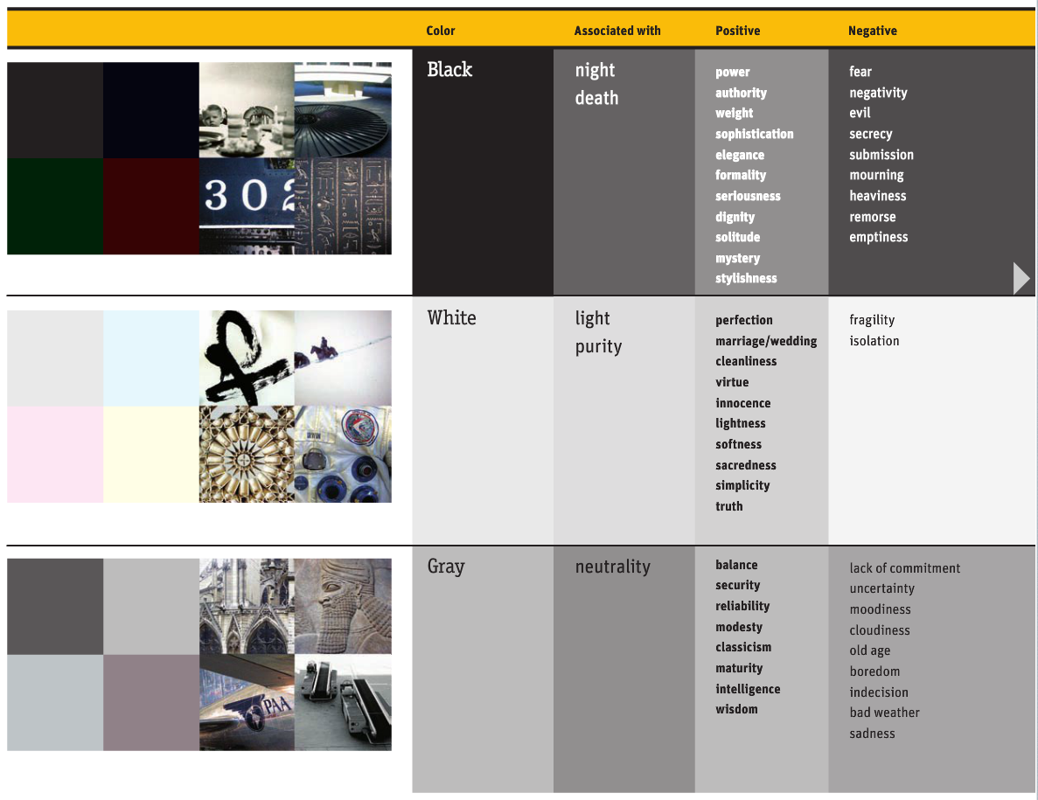
Neutral colour Meaning:
Black

Slide 22
Black
Associated with | Positive | Negative | Extra
Night Death | Power Authority Weight Sophistication Elegance Formality Seriousness Dignity Solitude Mystery Stylishness | Fear Negativity Evil Secrecy Submission Mourning Heaviness Remorse Emptiness | Absorbs all light (absence of colour) Slimming effect in clothing In design, conveys luxury, power, & exclusivity Associated with both sophistication (black tie) & danger (blacklist, black market)
Notes:
Black is tied to night and death It suggests power, elegance, and mystery but also fear, secrecy, and mourning It is timeless in fashion and often used for luxury design

Slide 23
Neutral colour Meaning:
White

Slide 24
White
Associated with | Positive | Negative | Extra
Light Purity | Perfection Marriage Wedding Cleanliness Virtue Innocence Lightness Softness Sacredness Simplicity Truth | Fragility Isolation | Reflects all light (sum of colours) Enhances sense of space Common in minimalist design Can symbolize both beginnings (birth, weddings) & endings (death)
Notes:
White represents light and purity It conveys innocence, simplicity, and truth, but may also suggest fragility or isolation In many cultures, it symbolizes both beginnings and endings

Slide 25
Neutral colour Meaning:
Gray

Slide 26
Gray
Associated with | Positive | Negative
Neutrality | Balance Security Reliability Modesty Classicism Maturity Intelligence Wisdom | Lack of commitment Uncertainty Moodiness Cloudiness Old age Boredom Indecision Bad weather Sadness
Notes:
Gray stands for neutrality and balance It suggests maturity and wisdom but can also mean dullness, sadness, or indecision In design, it is modern, professional, and understated

Slide 27
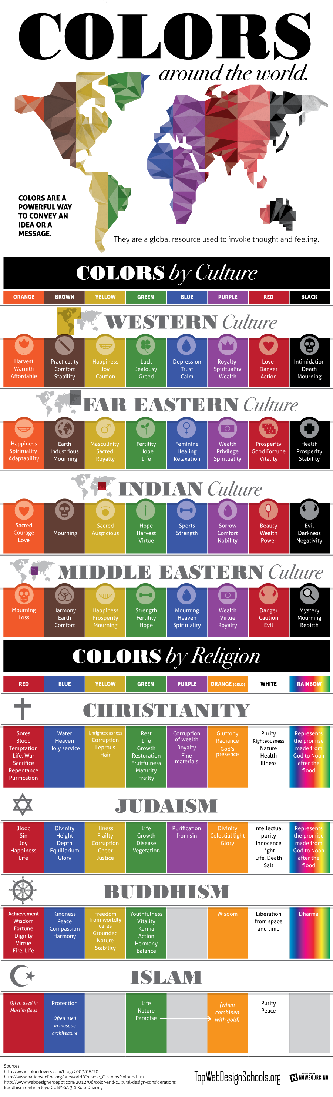
Culture Changes Meaning
Same colour, different meanings:
Notes:
Content
Same colour, different meanings:
We often assume colour meanings are universal.
They are not.
White often means purity in North America, but can symbolize mourning in some Asian cultures.
Red may signal danger in one culture while representing celebration and prosperity in another.
Whenever we design for broad audiences, colour choices should be researched rather than assumed.“
Image from: https://sl.bing.net/drIss9XoXF6
Colors-Around-The-World-Infographic-infographicsmania.png (900×2960)
https://infographicsmania.com/wp-content/uploads/2013/12/Colors-Around-The-World-Infographic-infographicsmania.png

Slide 28
Notes:
Content
Same colour, different meanings:
Image from: https://sl.bing.net/drIss9XoXF6
Colors-Around-The-World-Infographic-infographicsmania.png (900×2960)
https://infographicsmania.com/wp-content/uploads/2013/12/Colors-Around-The-World-Infographic-infographicsmania.png

Slide 29
Notes:
Content
Same colour, different meanings:
Image from: https://sl.bing.net/drIss9XoXF6
Colors-Around-The-World-Infographic-infographicsmania.png (900×2960)
https://infographicsmania.com/wp-content/uploads/2013/12/Colors-Around-The-World-Infographic-infographicsmania.png

Slide 30
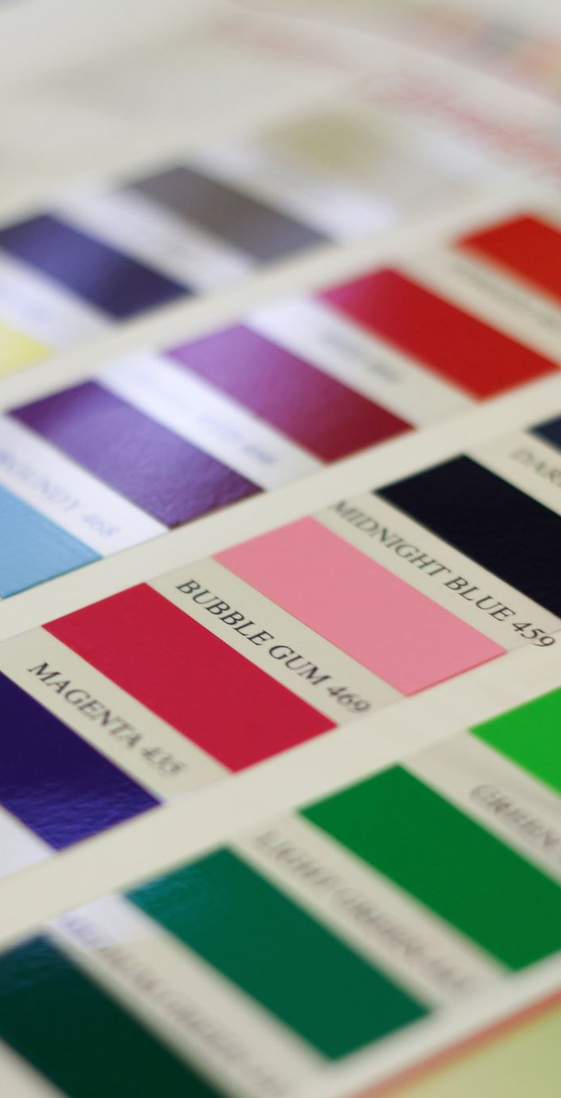
Research
Be sure to investigate a particular colour’s meanings and associations before using it in a project for any medium

Slide 31
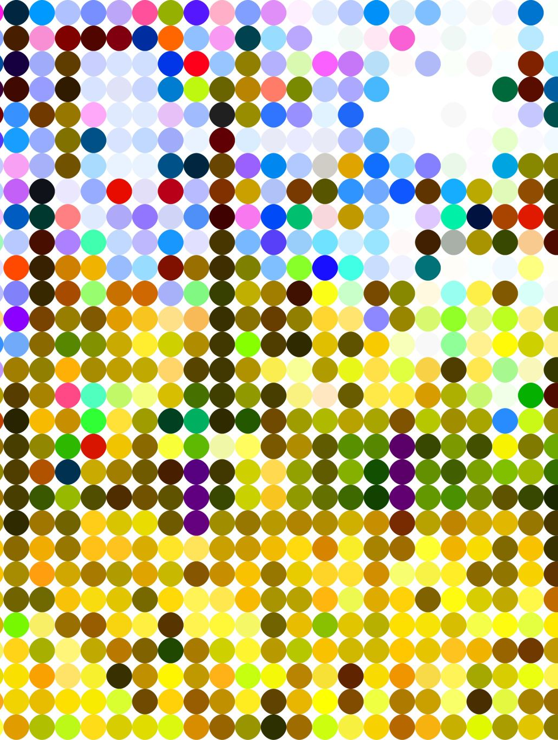
Colour Blindness & Inclusive Design
Approximately 1 in 12 men affected
Avoid colour-only communication
Use labels, icons and patterns
Test designs using simulators
Notes:
Visual
Side-by-side examples of normal vision and colour blindness simulation.
Good design works for everyone.
Many users experience some form of colour vision deficiency.
If important information relies only on colour, some people will miss it completely.
Always provide a second visual cue such as labels, icons, texture, underlines, shapes, or patterns.

Slide 32
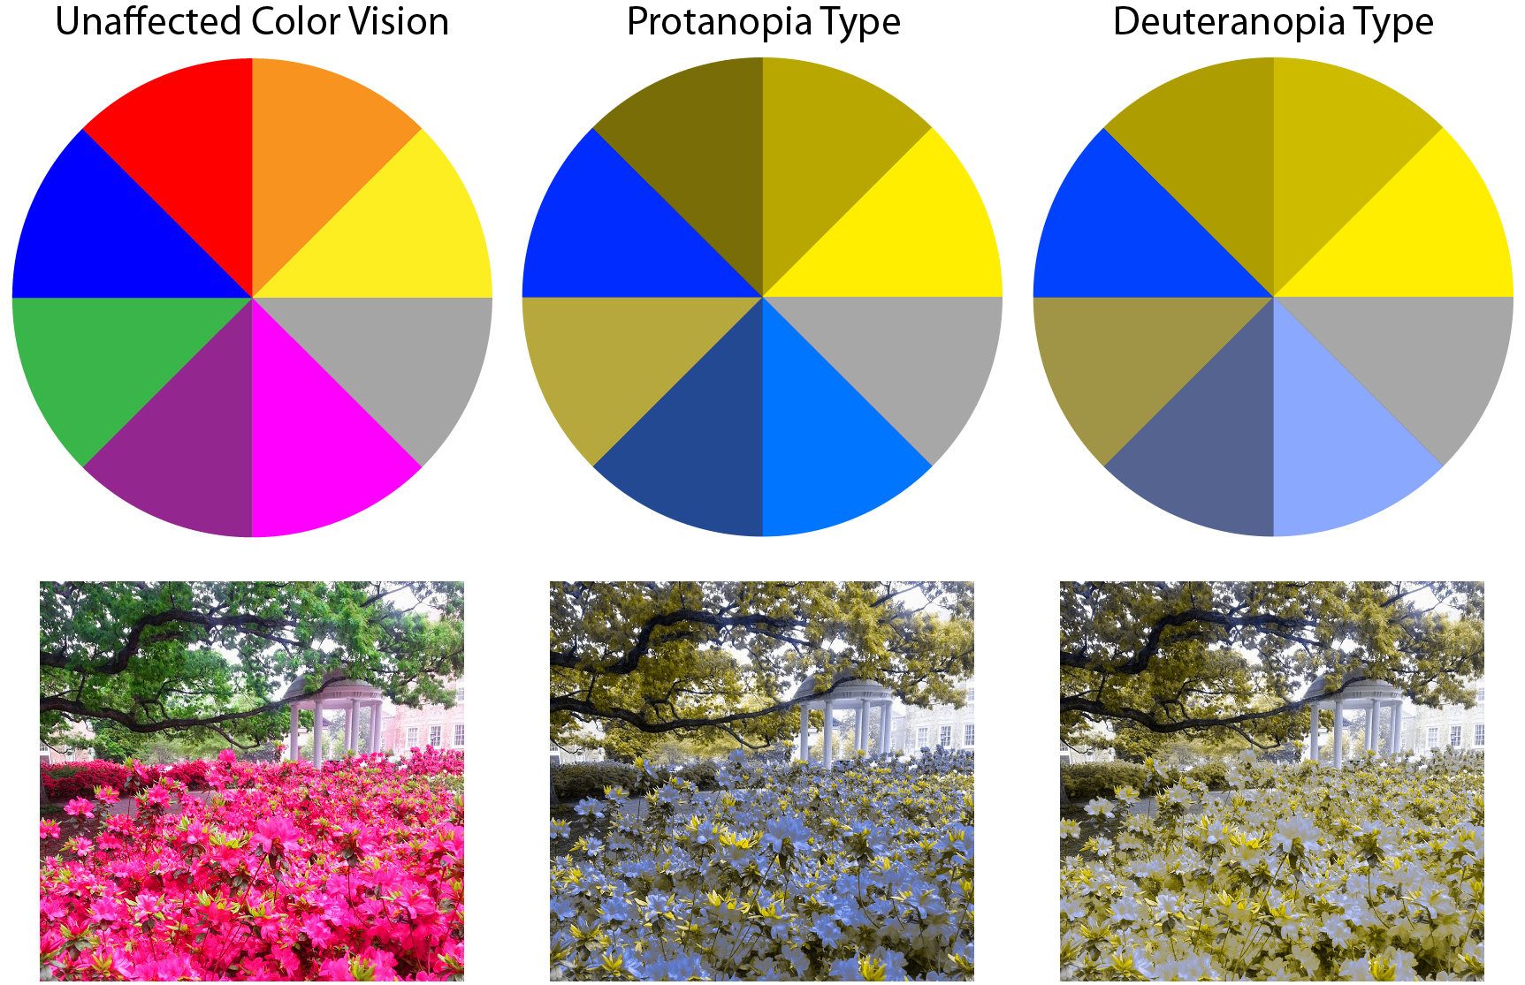
Notes:
Image from:
color-blindness-types-1.png (1725×1115)
https://iristech.co/wp-content/uploads/2018/05/color-blindness-types-1.png
https://sl.bing.net/gucv98cD4g0

Slide 33
Understanding WCAG Contrast Ratios
Web Content Accessibility Guidelines
These are international standards used to make digital content accessible to people with:
Low vision
Colour blindness
Aging eyesight
Screen magnification needs
Various visual impairments
Understanding the Numbers
AA Standard
4.5:1 normal text
3:1 large text
AAA Standard
7:1 normal text
Notes:
When we choose colours for text and backgrounds, appearance is not enough.
Accessibility standards measure readability using contrast ratios.
Dark grey text on slightly lighter grey backgrounds may look modern but often fails accessibility requirements.
Tools can instantly calculate whether colour combinations meet standards.
WCAG stands for:
Web Content Accessibility Guidelines
These are international standards used to make digital content accessible to people with:
Low vision
Colour blindness
Aging eyesight
Screen magnification needs
Various visual impairments
For designers, WCAG helps answer: "Can everyone read my design?"
Understanding The Numbers
What is a Contrast Ratio?
A contrast ratio measures the difference in brightness between two colours.
Typically, we are measuring:
Text colour
Background colour
For example: ✅ Black text on a white background vs. ❌ Light gray text on a white background
The greater the difference, the easier the text is to read.
AA Standard
Think of AA as: "Minimum Professional Standard"
Most organizations expect at least AA compliance.
Normal Text
4.5:1
Example: Dark blue text/ White background
✅ Pass
Large Text
3:1
Large text is easier to read.
Because it is larger, WCAG allows lower contrast.
Examples: Headings, Large titles, Hero text
AAA Standard
Think of AAA as: "Excellent Accessibility"
Normal text: 7:1
This is often used for: Government websites, Educational institutions, Accessibility-focused projects
Not every project achieves AAA compliance, but it is a good goal when possible.
Explain to the student like this:
Imagine you are trying to read a book in a dimly lit room. The letters don't change, but they become difficult to see because there isn't enough contrast between the text and its surroundings.
Digital design works the same way. If there isn't enough contrast between the text and background, users have to work harder to read what we've created.

Slide 34
Understanding WCAG Contrast Ratios
High Contrast
Black Text
White Background
Contrast Ratio ≈ 21:1
✅ Extremely readable
This is an example of high contrast
Notes:
Visual
Examples showing pass/fail combinations.

Slide 35
Understanding WCAG Contrast Ratios
Medium Contrast
Dark Gray Text
White Background
Contrast Ratio ≈ 7:1
✅ Readable
✅ Meets AAA Accessibility
This is an example of medium contrast
Notes:
Visual
Examples showing pass/fail combinations.

Slide 36
Understanding WCAG Contrast Ratios
Low Contrast
Light Gray Text
White Background
Contrast Ratio ≈ 2:1
❌ Difficult to read
❌ Accessibility failure
This is an example of low contrast
Notes:
Visual
Examples showing pass/fail combinations.

Slide 37
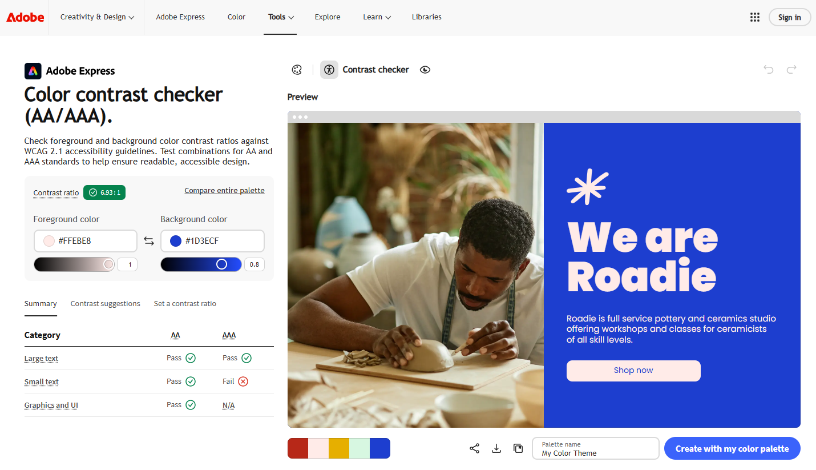
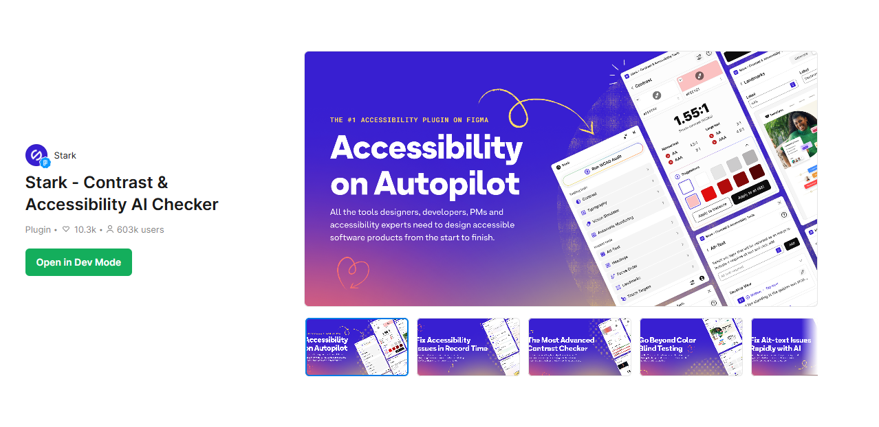
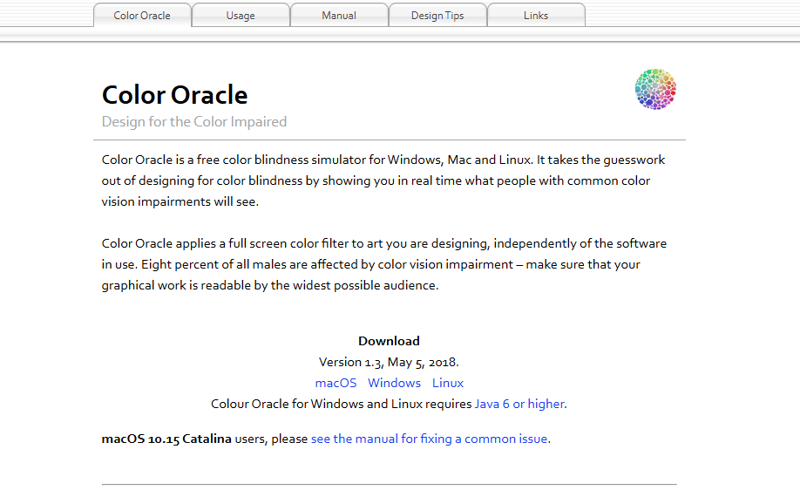
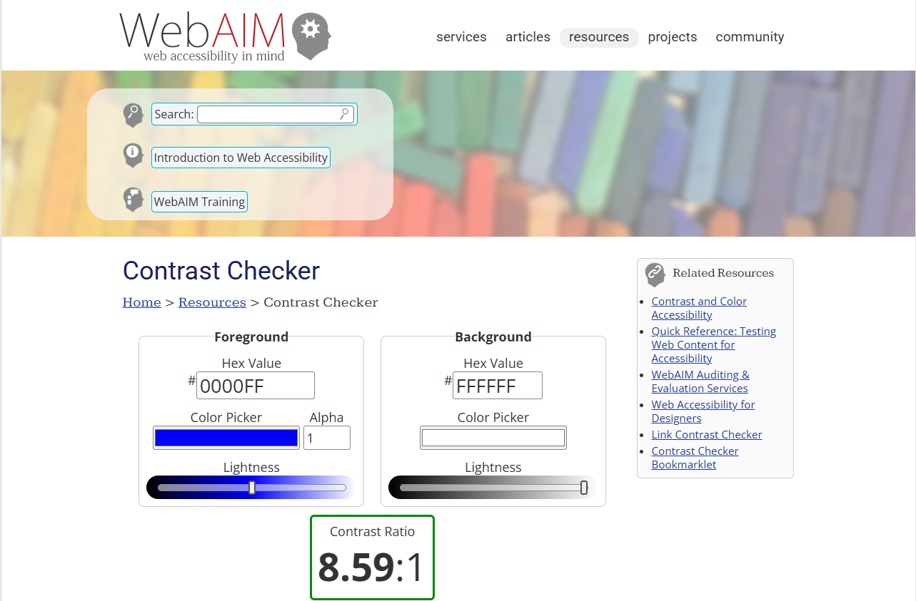
Accessibility Tools for Designers
WebAIM Contrast Checker
Adobe Color
Stark Plugin
Colour Oracle
Notes:
Professional designers don't guess.
They test.
These tools allow us to simulate colour blindness and verify contrast ratios before publication.
Accessibility is part of professional design practice and increasingly part of legal and organizational requirements.
Images from:
Screen shots of each tools website:
WebAIM: Contrast Checker
https://webaim.org/resources/contrastchecker/
Color Contrast Checker (AA/AAA) | Adobe Express​
https://color.adobe.com/create/color-contrast-analyzer
Stark - Contrast & Accessibility AI Checker | Figma
https://www.figma.com/community/plugin/732603254453395948/stark-contrast-accessibility-ai-checker
Color Oracle | Color Oracle
https://colororacle.org/

Slide 38
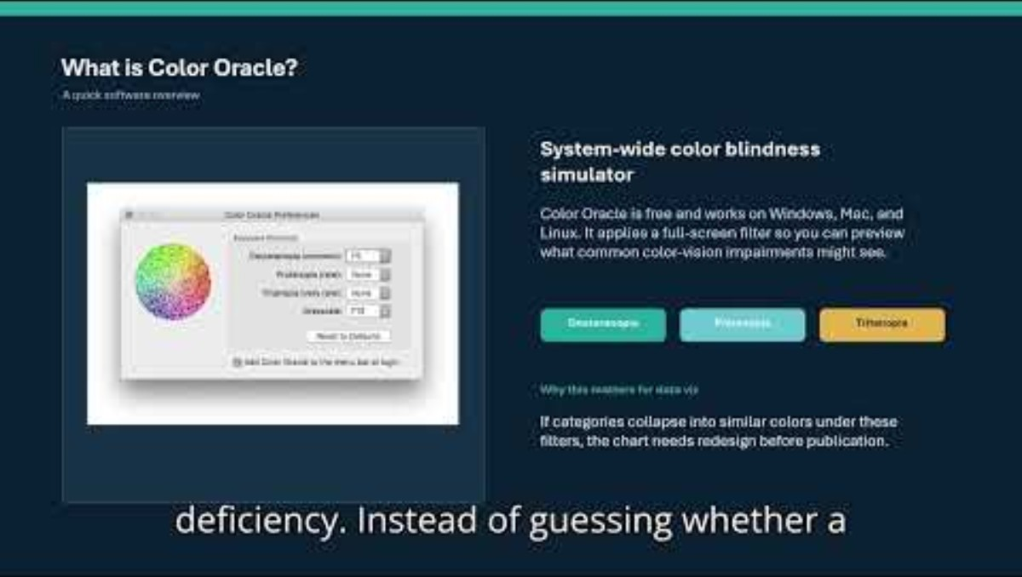
Notes:
https://youtu.be/-8VUMdWH568?si=IP7LyoeC5aM2Zm9W
How to use Color Oracle to identify color accessibility issues
Jialin Liu

Slide 39



Case Studies
Coca-Cola (Red – energy, excitement)
Starbucks (Green – calm, nature, balance)
IKEA (Blue + Yellow – trust + optimism)
This Photo by Unknown Author is licensed under CC BY-SA
This Photo by Unknown Author is licensed under CC BY-SA
This Photo by Unknown Author is licensed under CC BY-SA-NC
Notes:
3. Case Studies
Coca-Cola (Red – Energy, Excitement):
“Coca-Cola uses red because it’s tied to energy, excitement, and passion. It stimulates appetite and creates urgency. It’s no accident that red dominates food and beverage marketing.”
“Notice how they combine it with white for contrast and clarity.”
Starbucks (Green – Calm, Nature, Balance):
“Starbucks chose green to reflect growth, balance, and community. It ties to nature and sustainability, which aligns with their messaging about ethical sourcing.”
“Green also creates a calming environment—think of the experience inside a café.”
IKEA (Blue + Yellow – Trust + Optimism):
“IKEA uses the national colours of Sweden, but they also carry deeper psychology.”
“Blue = trust, reliability, structure (perfect for furniture and home goods). Yellow = warmth, optimism, affordability.”
“Together, they position IKEA as both dependable and approachable.”
4. Wrap-Up / Student Prompt
“So, when you see a brand, ask yourself: why did they choose these colours? What emotions or behaviours are they trying to trigger?”

Slide 40
Let’s Use one of the Tools
Adobe Color
Notes:
Color Contrast Checker (AA/AAA) | Adobe Express​
https://color.adobe.com/create/color-contrast-analyzer

